Slide 2
Choosing a course
What do I want to do when I leave university?
What are the degree requirements for that career?
What courses could I do?
Which is going to give me the most options when I finish?
Do I want the option of a sandwich course?
Do I want the option of a masters degree?
Do I want the opportunity for a placement abroad?

Slide 3
Choosing a university
Which offer the courses I want?
Where does the course rank nationally against others?
Do I want to go to a Russell Group university?
Do I want to apply to Cambridge?
What facilities does the university offer?
Am I likely to be able to meet the entry requirements of the university?

Slide 4
Key questions to ask yourself
Do you want to be close to home?
Do you want to live at home to save money?
Do I want a campus university or one in a town?
Do I want to be a large or small town?
How often will I want to come home and how much will this cost?
How much will the accommodation cost?

Slide 5
Finding the right university
Research!

Slide 6
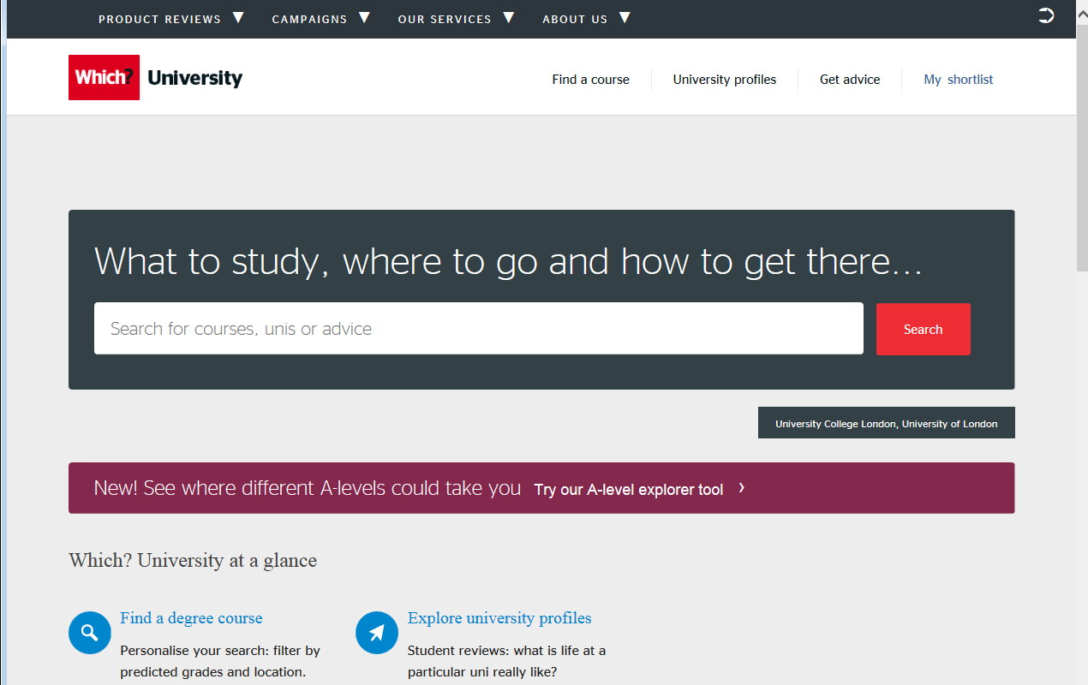

Slide 7
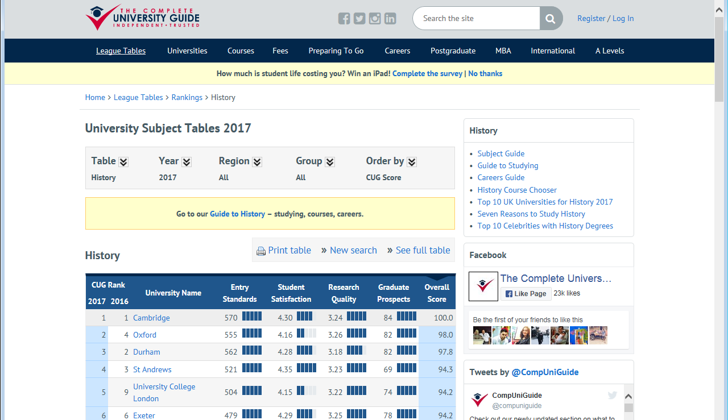

Slide 8
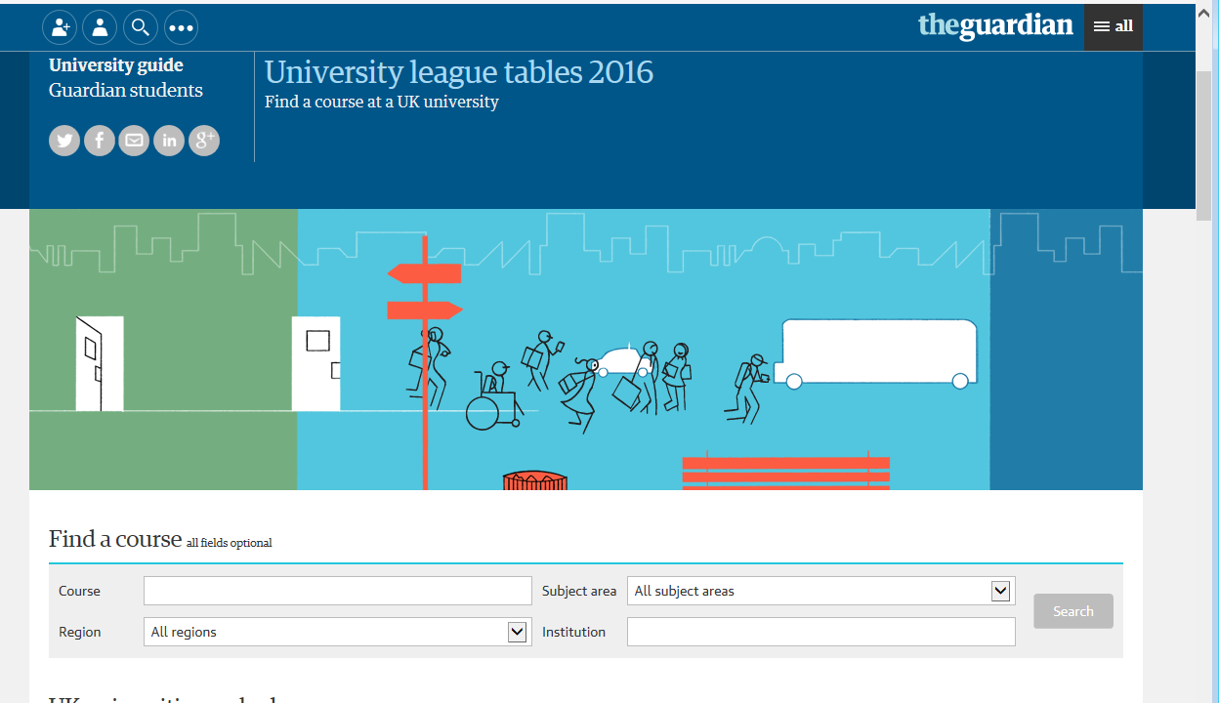

Slide 9
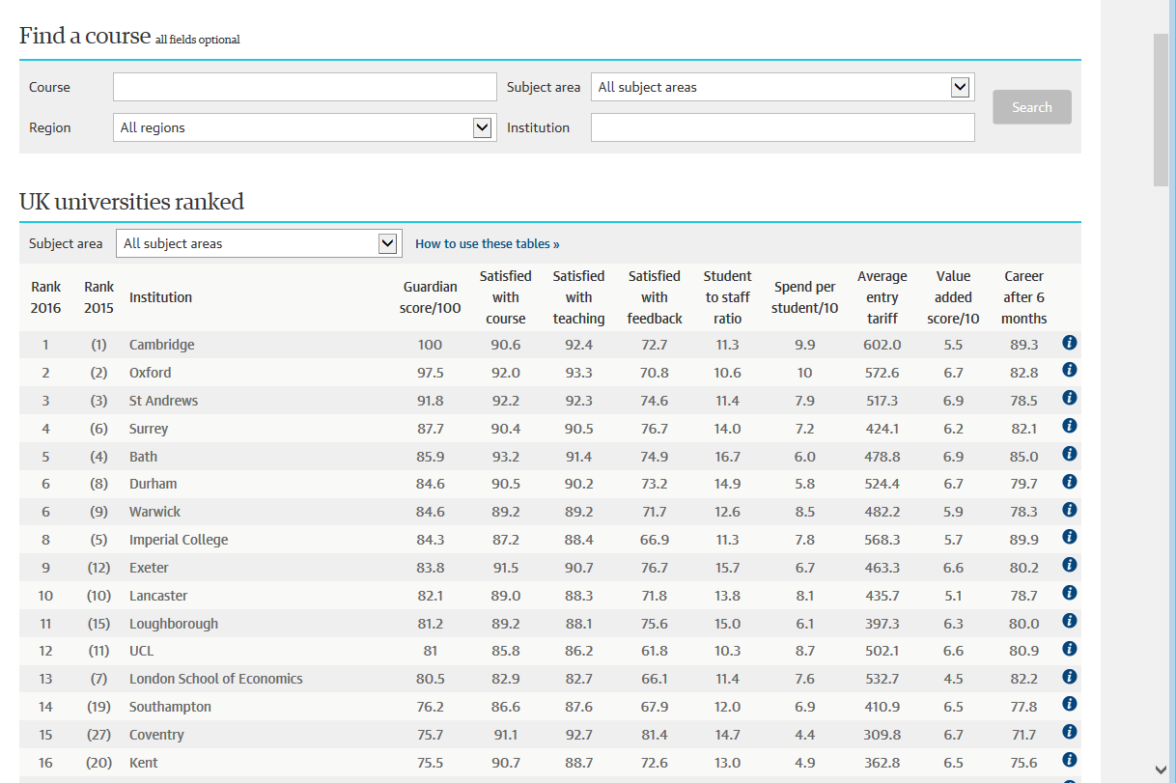

Slide 10
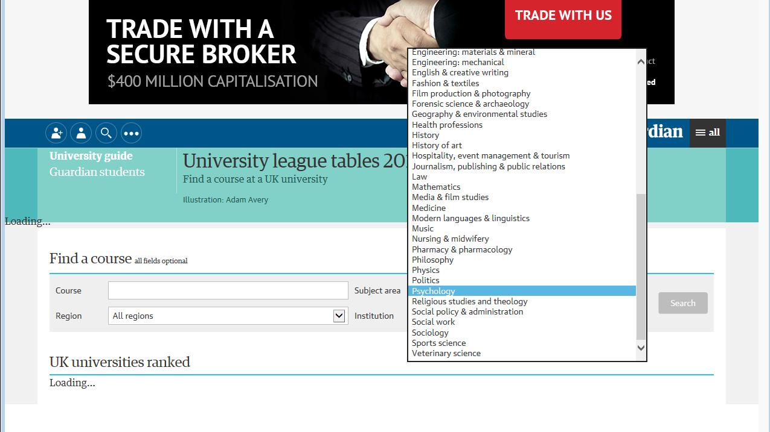

Slide 11
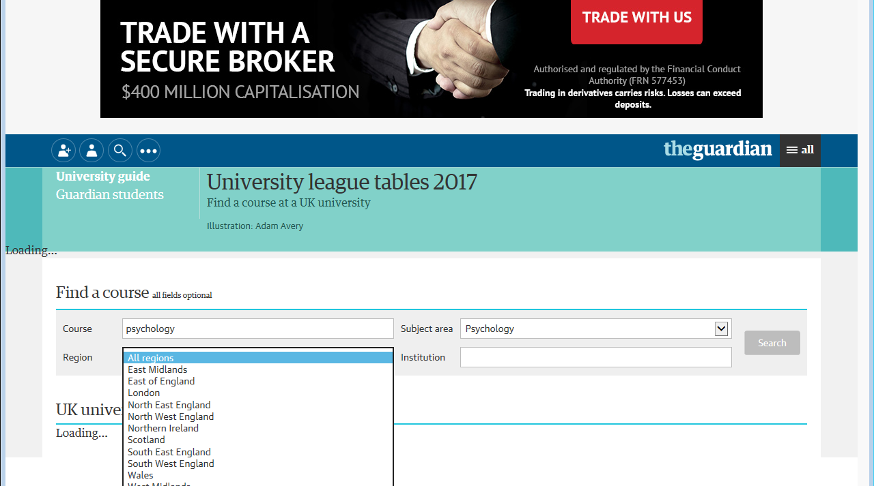

Slide 12
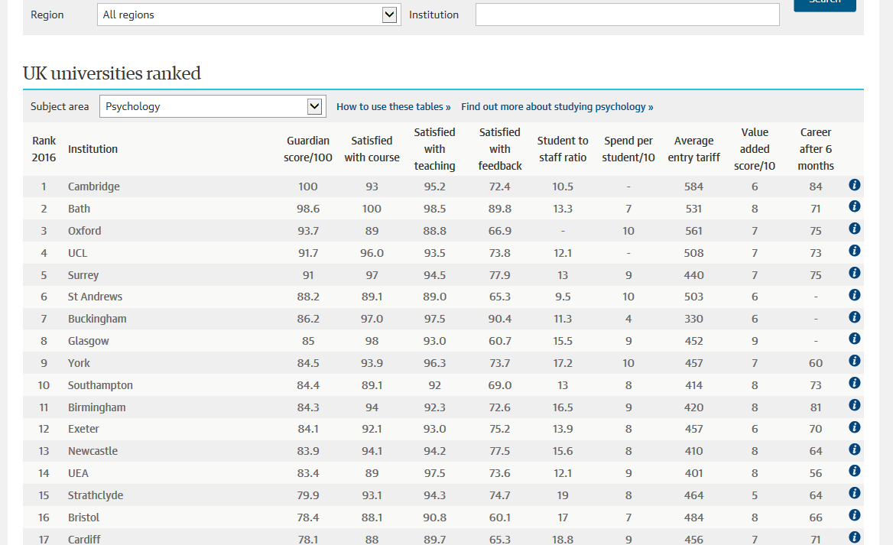

Slide 14
Choosing a university
Now start drawing up a short list of universities which you might consider
Remember to choose a range of entry requirements and list them in your book (page )
If you any specific questions do not be afraid to contact the admissions department of a university – they will fall over themselves to help you
Remember – they need you more than you need them

