Slide 1
The Cottesloe School

Slide 2
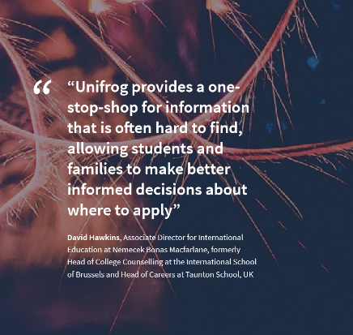
What we provide to students
Unifrog is the one-stop-shop for destinations, allowing students to explore every university course, apprenticeship and college course in the UK plus other around the world opportunities such as European and US undergraduate courses
They can make applications using Unifrog and receive feedback from teachers along the way. This includes create their personal statement and CV, plus more!

Slide 3
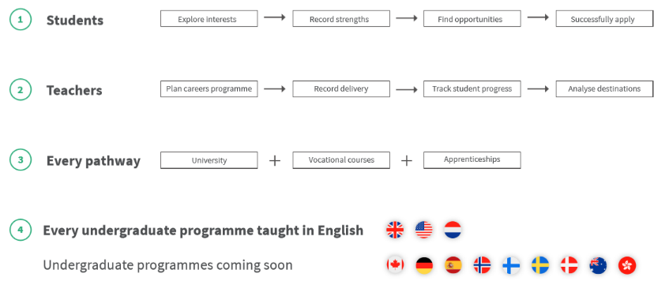
One-stop-shop

Slide 4
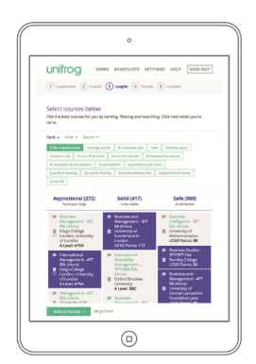
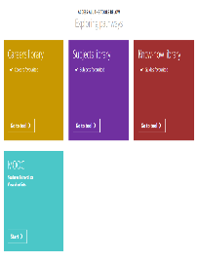
Students Exploring Pathways
Our Tools:
Research future careers
Explore subject profiles
Make considered choices
De-mystify applications
Careers library
Subjects library
MOOC
Know-how library

Slide 5
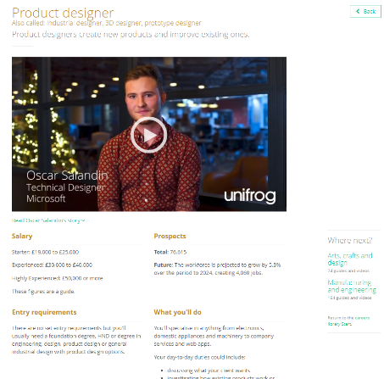
Read profiles on over 900 different careers and learn how to get in to them

Slide 6
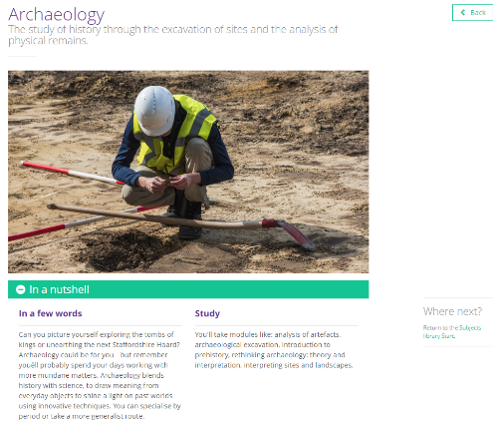
Explore potential university subjects suited to your interests and skills

Slide 7
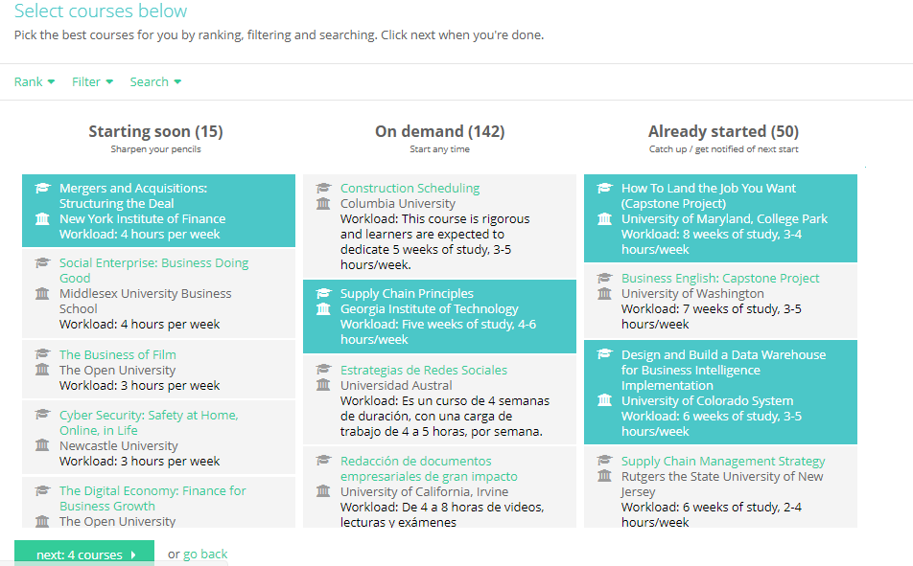
Complete a MOOC to develop interests and explore subjects in depth

Slide 8
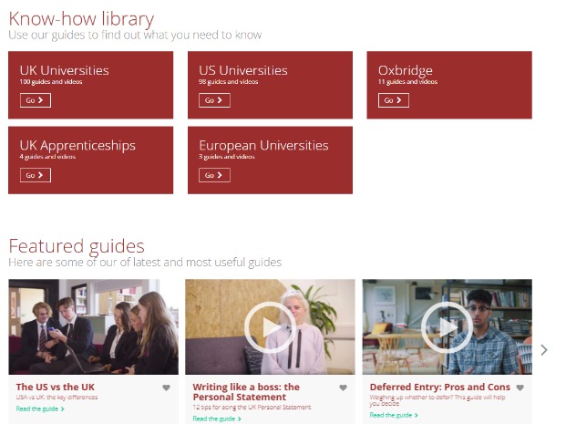
Search the database of guides to help you across multiple applications

Slide 9
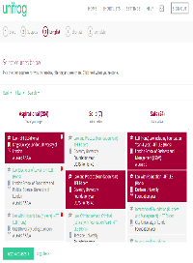
Students Searching for Opportunities
Our Tools:
Everything in one place
Intuitive process
Compare side by side
Make considered choices
Tailored to individual students
UK Universities
Apprenticeships
Oxbridge
US Universities
European Universities
College/ Sixth Form

Slide 10
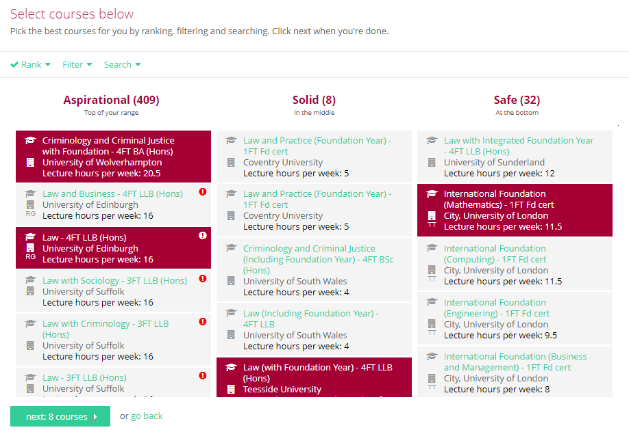
Search Unifrog to find the most suitable university courses for you

Slide 11
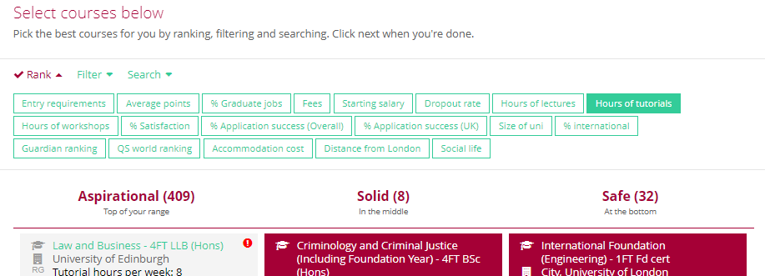
Smart ranking and filtering tools enable you to make informed choices

Slide 12
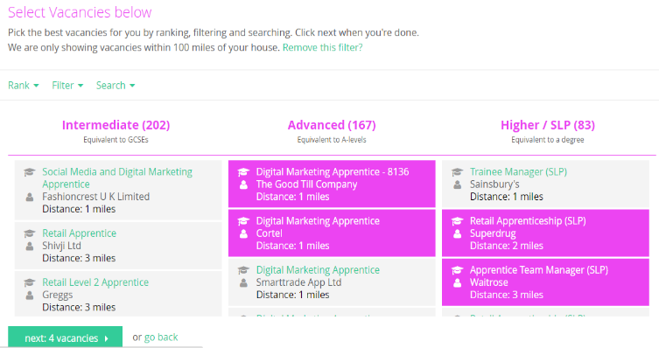
Updated every 24hrs, use Unifrog to find the best apprenticeships

Slide 13
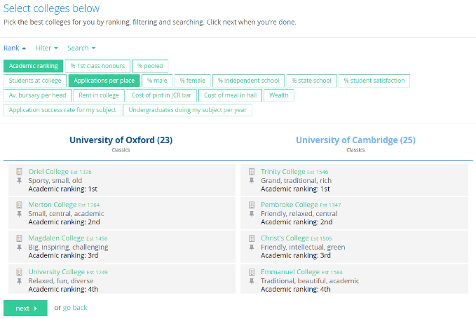
Unifrog’s Oxbridge tool de-mystifies the application process

Slide 14
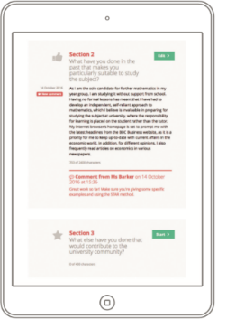
Students creating applications
Our Tools:
UK Top 5
Manage everything from one dashboard
Guidance and examples
Nothing gets lost
Easy feedback on personal statements and references
CV/Resume
Activities
Competencies
Interactions
UK Personal Statement
Teacher References
Post 18 Intentions

Slide 15
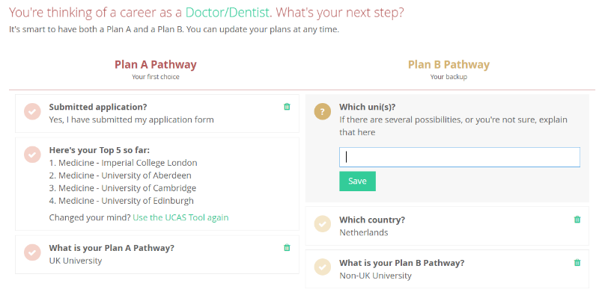
Students build effective, personal applications
Notes:
Emphasise that for other qualification types this will be adjusted on Unifrog accordingly.

Slide 16
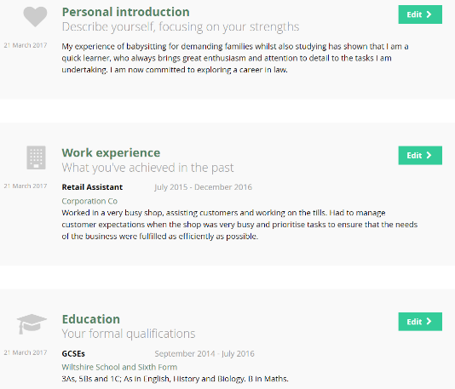
Students build effective applications with personal career goals
Notes:
Emphasise that for other qualification types this will be adjusted on Unifrog accordingly.

Slide 17
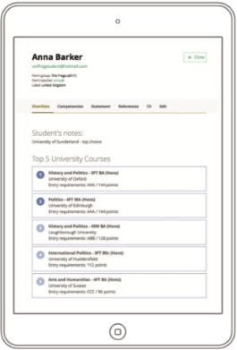
Supporting teachers to manage students
Track progression
Contact staff and students
Assess students’ interests
Support at every stage

Slide 18
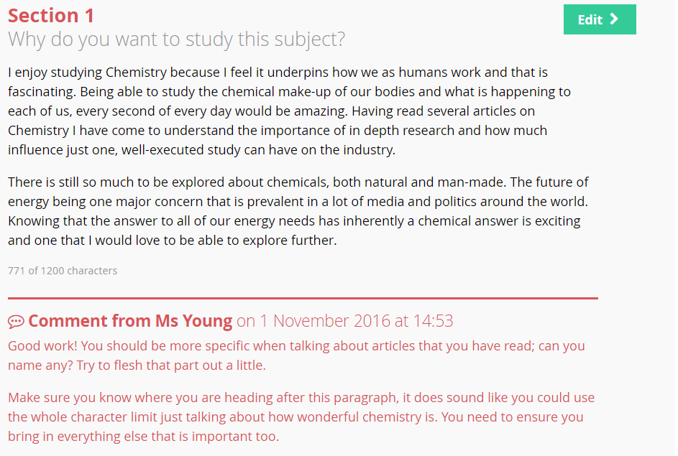
Teachers can add comments directly on Unifrog, supporting students in real time.

Slide 19
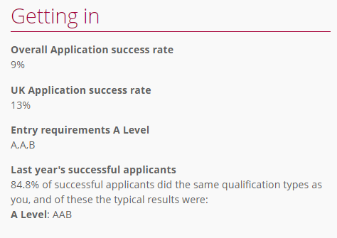
How can Unifrog improve attainment?
Students can see clearly what grades they need to achieve at GCSE and A-level for certain courses. GCSEs are increasingly important with the new linear A-levels and no AS results.
It also helps ensure that students don’t restrict themselves early because they are aware of subject and grade requirements.
Notes:
Emphasise that for other qualification types this will be adjusted on Unifrog accordingly.

Slide 20
How can Unifrog improve aspirations?
Unifrog gets students thinking about university early. It allows them explore courses that they may never have heard of before in a way that is relevant for them and they can absorb.
They will become familiar with Russell Group universities and Oxbridge colleges so that when they come to apply, the increased exposure will mean they are more likely to apply to the best universities for them.

Slide 21
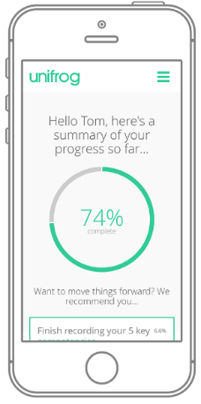
unifrog.org/student Form code parentscottesloe

