Slide 1
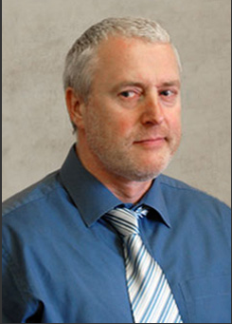
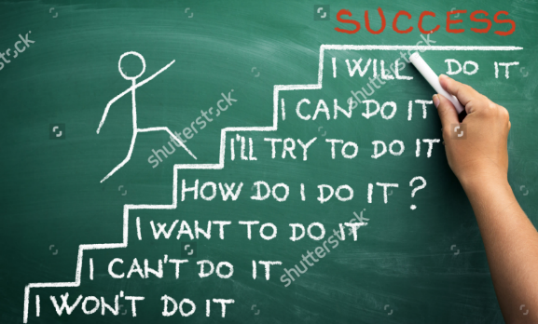
Train Like A Champion
Year 13 Easter Assembly

Slide 2
How hard to you work?
A2 Students
AS Students
Student A - AAAA*
25 hours
Student B – AAB
25 hours
Student C – D A*A*
26 hours
Student D – DEU
3 hours
Student E – DEE
- 5 hours
Student A – AAB
22 hours
Student B – AAA
20 hours
Student C – ABB
20 hours
Student D – UUE
1 hour
Student E – UEE
- 4 hours

Slide 3
How hard do you work?
1 = 0-2 Hours per week
5 = 10 hours per week
10 = 25 hours per week
1 2 3 4 5 6 7 8 9 10

Slide 4
How hard do you work?
‘You are the average of the five people that you spend the most time with’
Those who appear low on the scale will have surrounded themselves with others who apply a similar amount of time. That way they can feel reassured about their actions or lack of them!
‘At least I do more than her!’

Slide 5
Who works the longest?
UK average – 36.3 hours per week
Teacher – 49 hours per week
Politician – 69 hours per week
Junior Doctors – 100 hours per week

Slide 6
Training for your final
It’s all in the Preparation!
Prepare in order to succeed or else prepare to fail

Slide 7
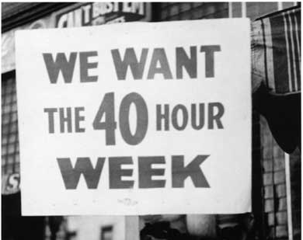
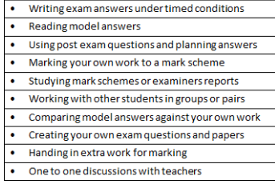
Training for your final
Work hard
Work Smart

Slide 8
Training for your final
1 grade
Minimum

Slide 9
Training for your final
SMART Targets
Short term – daily
Medium term – weekly
Long term – end of the year
S – Specific
M – Measurable
A – Achievable
R - Recorded
T – Time framed

Slide 10
Training for your race
Have a training schedule and stick to it

Slide 11
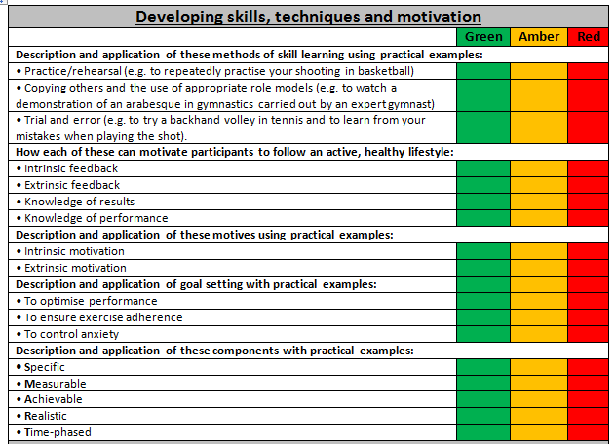
Specificity Focus on the things you need to know

Slide 12
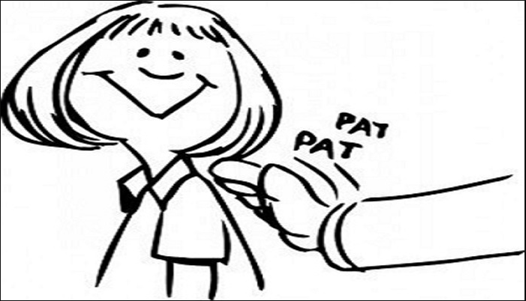
Training for your final
Focus on the weaknesses in your game and avoid ‘ego practice’

Slide 13
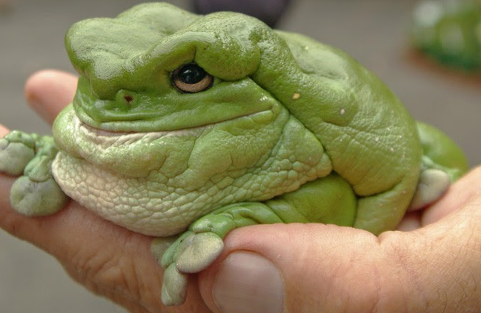
Training for your final If you have to eat two frogs eat the ugly one first

Slide 14
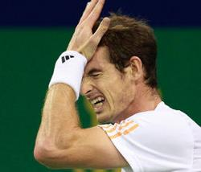
Training for your final
Find the weakness in your game

Slide 15
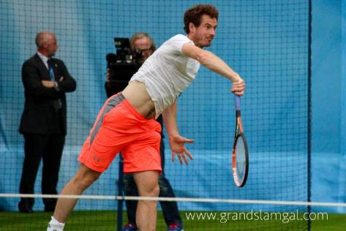
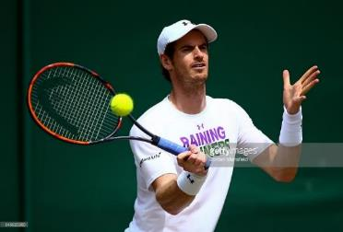
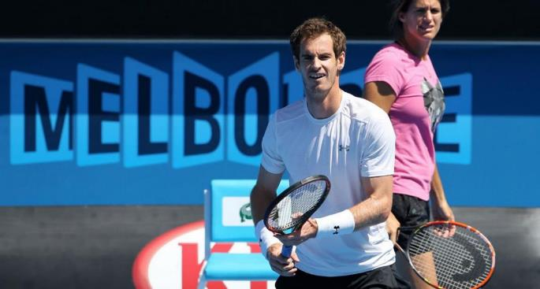
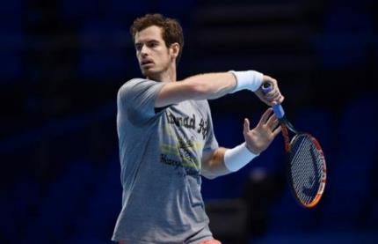
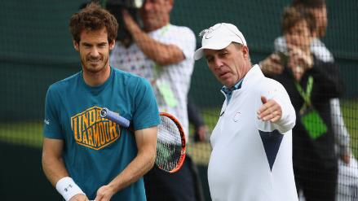
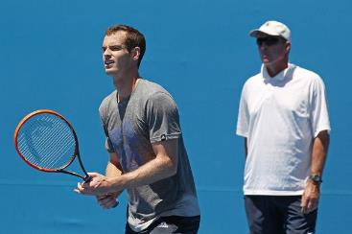
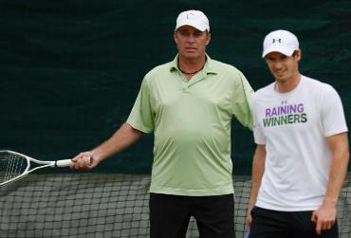

Slide 16
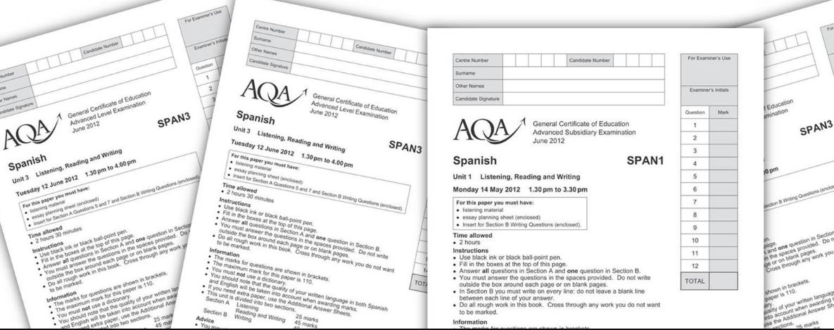
Training for your final Overload – Harder/more often/for longer

Slide 17
Training for your final Progression – gradually increase the workload

Slide 18
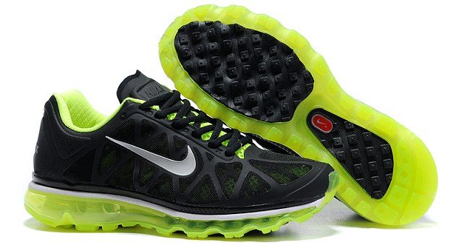
Training for your final Find your comfy shoes and train in them

Slide 19
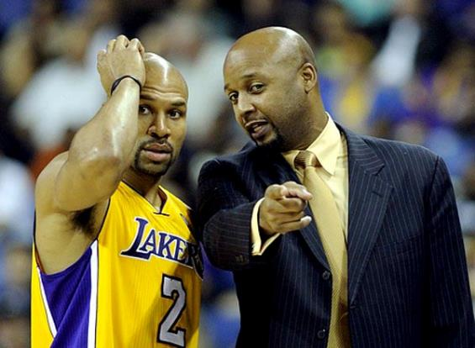
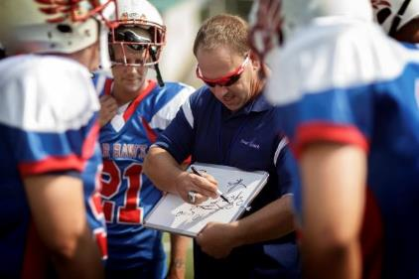
Training for your final
Spend as much time with your coach as you can and get feedback and practice ideas

Slide 20
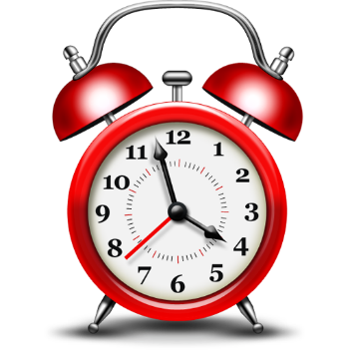
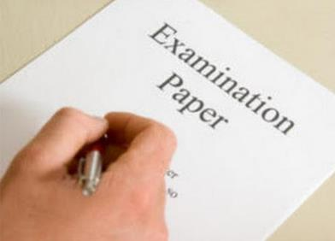
Training for your final Sort your body clock

Slide 21
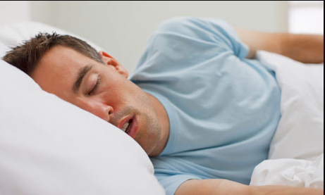
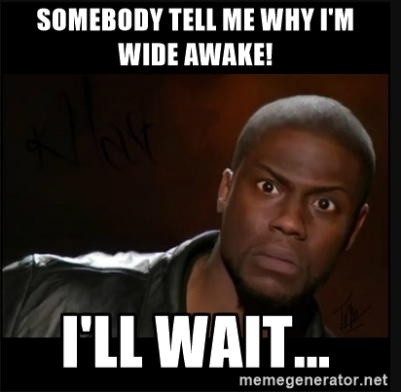
Training for your final
Event rehearsal – train at the same time as your event e.g. 9.00am – get your body in the routine

Slide 22
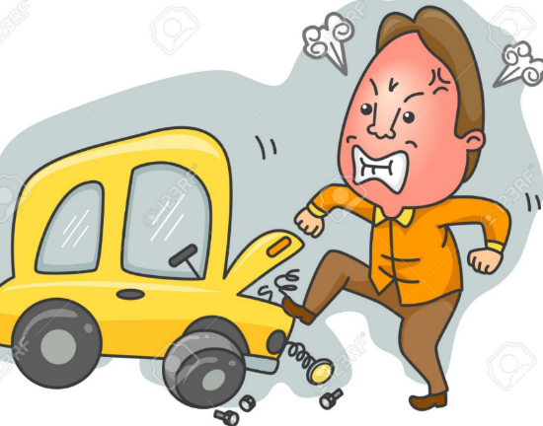
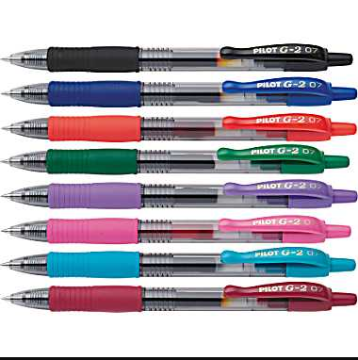
Training for your Final
Anticipate problems

Slide 23
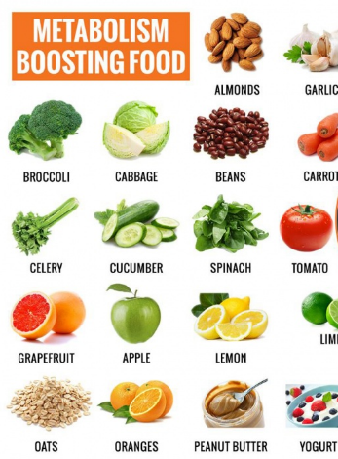
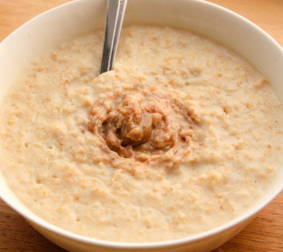
Training for your final Get your diet right

Slide 24
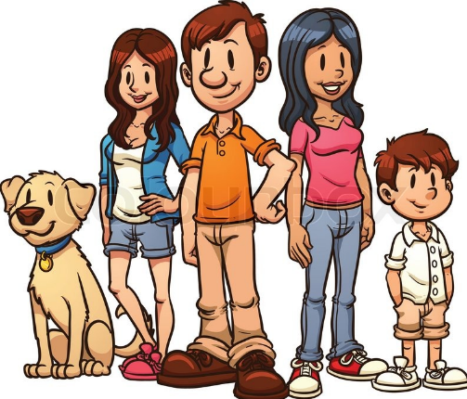
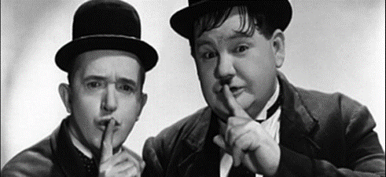
Training for your final Make sure that others are prepared too

Slide 25
Training for your final Remind yourself why you are doing all of this and the rewards at the end

Slide 26
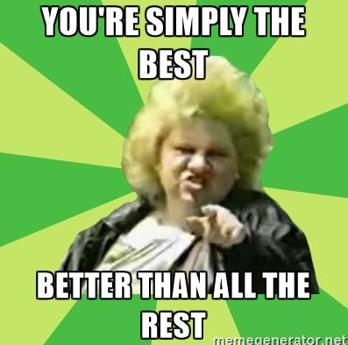
Training for your final Believe

