Slide 1
Core Evening PPT Slides
Welcome to
The Yr 11 Core Evening
2019

Slide 2
Sixth Form
Grade 4 ‘standard pass’
Grade 5 ‘ strong pass’
5 Standard Passes including English
A-Levels require a minimum of a grade 6 in particular subjects
BTEC qualifications require a minimum of a grade 5 in English in addition they might require subject specific outcomes.

Slide 3
What makes a difference?
Parental support is eight times more important in determining a child’s academic success than social class (DFE)

Slide 4
Attendance Matters: Data 2019
78% with over 95% Attendance achieved a pass in Maths and English
38% with below 90% Attendance achieved a pass in Maths and English
Impact of 5%
95% attendance required for Sixth Form

Slide 5
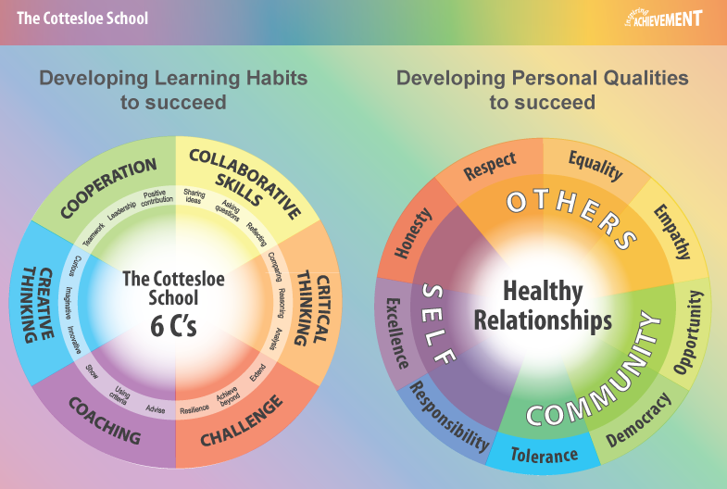
The Character of a successful student
Have the right ‘can do’ mind-set
Be self-motivated
Be resilient – make mistakes and learn from them
Complete homework set
‘Device-Free’ work time
Organisation of time
Correct equipment
Wellbeing – eat and sleep well
Revision – plan your weekly programme
Be the best you can be and have a vision about what you want to achieve

Slide 6
Information
Exam Preparation and Revision Booklet
Courses and exam board information
Mock Exam Timetable - copy of the general Mock Exam Timetable on website.
This year, students will also be receiving individualised timetables and seating plans.

Slide 7
Cottesloe School Achievement Leaders
The link between subjects and students:
Miss Felton & Mr Passaro

Slide 8
How we support in Year 11:Raising Standards’ Strategy for the Year Ahead
Additional Learning Opportunities and Interventions
Lunchtime support – A5 and subject specific sessions
Guidance: revision guides, revision sessions, preparation for exams.
Small group support i.e. exam anxiety support
Close links with Sixth Form and Sixth Form mentors
Futures interviews, (29th January)
Careers consultation

Slide 9
How we support in Year 11:Raising Standards’ Strategy for the Year Ahead
Strategies to support the More Able
2 sets of mock exams (November and March)
Diagnosis – Therapy – Testing
Personalised Learning Checklists (PLCs)
Marking, Feedback and Fix-it
Use of exam questions in lessons and at home
Academic Mentoring

Slide 10
SCIENCE

Slide 11
Science Curriculum Intent
Through the study of science students learn about themselves, their health and their place within, and impact on, local and global communities
Students will develop into informed citizens who are able to understand and critique the world around them.

Slide 12
Exam Board and Courses
TRILOGY COMBINED SCIENCE (AQA )
- GCSE combined science
TRIPLE SCIENCE (AQA)
GCSE BIOLOGY
GCSE CHEMISTRY
GCSE PHYSICS

Slide 13
Combined Science Assessment
6 x 1h 15min exams
Qualification = 2 x GCSE grades

Slide 14
Triple Science
2 x 1h 45min exams for each of the subjects
Qualifications = 3 x GCSE grades
(Biology, Chemistry, Physics)

Slide 15
Grades
Easy for Triple 9-1 the same as other subjects
Not quite so easy for the Combined Science!
17 possible grades for the combined science
1 – 1
5 – 5
9 – 9
5 – 4
4 – 3
8 – 7
9 - 8

Slide 16
What Happens this year?
There are 24 (25 for triple) units covered in Science.
We only have 6 (7) left to cover this year (25% of the GCSE)
Completion – early next year
Maximising in school revision

Slide 17
Key Dates
7th October – Assessment Point 1 Exam
20th November – Mock Round 1
2nd March – Mock Round 2
Walking Talking Mocks
Walking Talking Mocks
Revision

Slide 18
November Mocks
Important – treat these like the real exams!
These will cover Paper 1 content only (see letter and information on SMHW)
Each student will sit 3 x papers
Combined
1h15min Biology
1h15min Chemistry
1h15min Physics
Triple
1h40min Biology
1h40min Chemistry
1h40min Physics

Slide 19
March Mocks
Important – treat these like the real exams!
These will cover Paper 2 content only (see letter and information on SMHW)
Each student will sit 3 x papers
Combined
1h15min Biology
1h15min Chemistry
1h15min Physics
Triple
1h40min Biology
1h40min Chemistry
1h40min Physics

Slide 20
Resources
Revision Guides (School Shop)
Seneca learning (codes on SMHW)
Revision cards (School Shop)
Kerboodle (Codes available soon…)
Past exam papers (AQA website)
Intervention Booklets (SMHW)

Slide 21
Past Exam Material
http://www.aqa.org.uk/subjects/science/gcse
AQA Website

Slide 22
Where to go…
Click here for Biology
Click here for Chemistry
Click here for Chemistry
Click here for combined science

Slide 23
Additional Support
Intervention Sessions
Drop-in Clinics
Easter Revision
Trips
Walking Talking Mocks

Slide 24
Science Specific Preparation
Knowledge
Application/Practice
Mind maps, check lists, revision cards, revision guides, revision notes, Seneca, Tassomai etc
Past Papers, Assessment point tests, mock exams, work books, intervention booklets

Slide 25
Focus
6 Mark Questions/RATE Questions
Intervention booklets
Build knowledge base

Slide 26
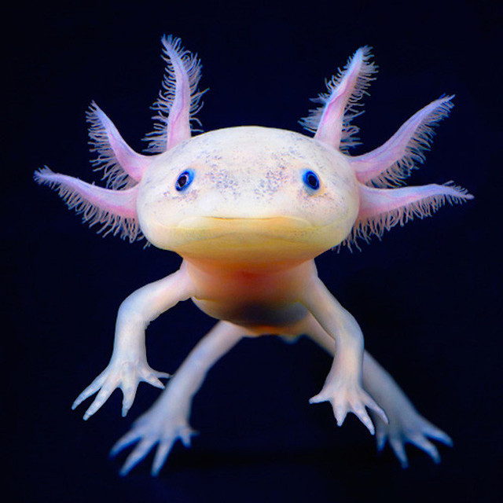
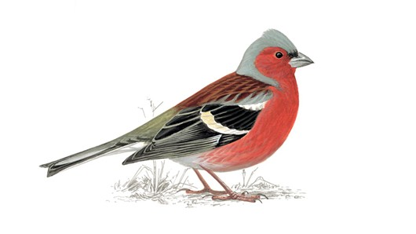
Chaffinch
Unfamiliar Content

Slide 27
THE BEST WAY TO DO IT…
…IS TO DO IT!

Slide 28
The English Department
Mrs. J. Webber
Head of English
Ms. G. Parris-Hammons
Second in English
Core Evening: 26th September, 2019
Prepare, Aspire, Succeed

Slide 29
The Cottesloe School: 83%
English GCSE Results (4 and above) 2019:
National Average: 67%

Slide 30
How We Achieved Success.
Expert teaching which uses Model answers, Fix-It and Personalised Learning Checklists to enable students to make excellent progress.
Interventions – in Form times, after school and holidays, to target particular students and enable them to improve upon their grades.
Teacher
Student
Parent
Partnership

Slide 31
What Students Can Do to succeed this year.
Understand what is expected for both examination papers in terms of: Timings / Each Question / Assessment Objectives / Mark Schemes/Examiners’ Reports
Practice Makes Perfect: complete as many past papers as possible.
Resilience is key: don’t give up!
Accept all Offers of Help: come to revision sessions, form time / after school interventions.
Be Revision Smart: the best revision for English Language is practising questions under timed conditions.

Slide 32
English Language
Paper 1: Explorations in Creative Reading and Writing
50% of GCSE English Language.

Slide 33
Paper 1: 1 Hour and 45 Minutes
Reading: Worth 50% of the marks.
Next, they have to answer 4 questions which test different reading skills. (45 Minutes)
Students are provided with an extract from a text – usually a short story or the beginning of a novel – and they are given 15 minutes to actively read and annotate it.
Writing: Worth 50% of the marks
Students have a choice of two tasks: Usually, there is a picture and students are asked to write a description. Or, they have to write a narrative (story). Occasionally, the question about the picture will ask them to write a story. (45 Minutes)

Slide 34
HOW to PREPARE: Reading
Read lots of different beginnings of stories and practise the set questions:
Q1: Comprehension
Q2: Analysis of Language
Q3: Structure
Q4: Evaluation

Slide 35
How to Prepare: Writing
Prepare lots of descriptions of places and people. The photographs tend to be of locations, modes of transport, interesting characters. By practising writing about lots of different people, places and things, you will develop a repertoire of phrases that you should be able to use in the examination.

Slide 36
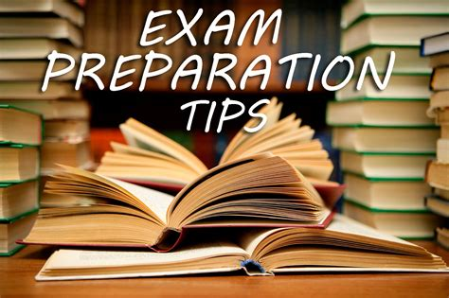
How to Prepare Writing (2)
Remember: ‘SPaG’ is worth 16 out of 40 Marks.
Think carefully about the punctuation you use. Try to vary it and create effects through it.

Slide 37
English Language
Paper 2: Writers’ Viewpoints and Perspectives
50% of GCSE English Language.

Slide 38
Paper 2: 1 Hour and 45 Minutes
Reading: Worth 50% of the marks.
Students are given 15 minutes to actively read two non-fiction extracts. One is usually a Nineteenth Century text and one is more modern.
Next, they have to answer 4 questions which test different reading skills. (45 Minutes)
Writing: Worth 50% of the marks.
Students are required to write a non-fiction response to a given statement. (45 Minutes)

Slide 39
How to Prepare: Reading
Read lots of non-fiction articles – especially newspaper articles from present day and in the past. (Victorian)
Practise Reading Skills:
Q1: Comprehension
Q2: Inference
Q3: Analysis of language
Q4: Comparing perspectives

Slide 40
How to Prepare: Writing
Practise writing different types of non-fiction texts such as:
Letters / Newspaper articles / Speeches / Essays.
Try to vary your writing to suit different audiences and purposes.
Again, SPaG is worth 16 out of 40 Marks.

Slide 41
Key Examination Dates: English Language
Mock Examinations:
Paper1: Wednesday, 20th November
Paper 2: Monday, 25th November
Public Examinations:
Paper 1: 2nd June, 2020
Paper 2: 5th June, 2020

Slide 42
Prepare Aspire succeed

Slide 43
English Literature
Paper 1: 64 marks Shakespeare and the 19^{th-} Century Novel
40% of GCSE English Literature.

Slide 44
Paper 1: 1 Hour and 45 Minutes
Section A
Shakespeare: Macbeth
Worth 50% of the marks.
Section B
19th –Century Novel
The Sign of the Four/
A Christmas Carol
Worth 50% of the marks.
Marks: 34
(an extra 4 marks for spelling, punctuation and grammar)
Students answer one question on the studied text. They will be given an extract to analyse and will also be expected to refer to the whole text.
Marks: 30
Students answer one question on the studied text. They will be given an extract to analyse and will also be expected to refer to the whole text.
*This is an extract-to-whole-based paper.

Slide 45
English Literature
Paper 2: 96 marks Modern Texts and Poetry
60% of GCSE English Literature.

Slide 46
Paper 2: 2 hours and 15 minutes
Section A: 34 marks
Modern Prose or Drama
An Inspector Calls
Answer one question (from a choice of two) on the studied text.
Section C: 32 marks
Unseen Poetry
Answer two questions on unseen poetry
Section B: 30 marks
Poetry Anthology
Power and Conflict Cluster
Answer one question, comparing two poems.
This paper requires students to explore a character, theme or idea in each section.
In the poetry sections, students are also required to compare how a theme, idea or topic is presented in two poems.

Slide 47
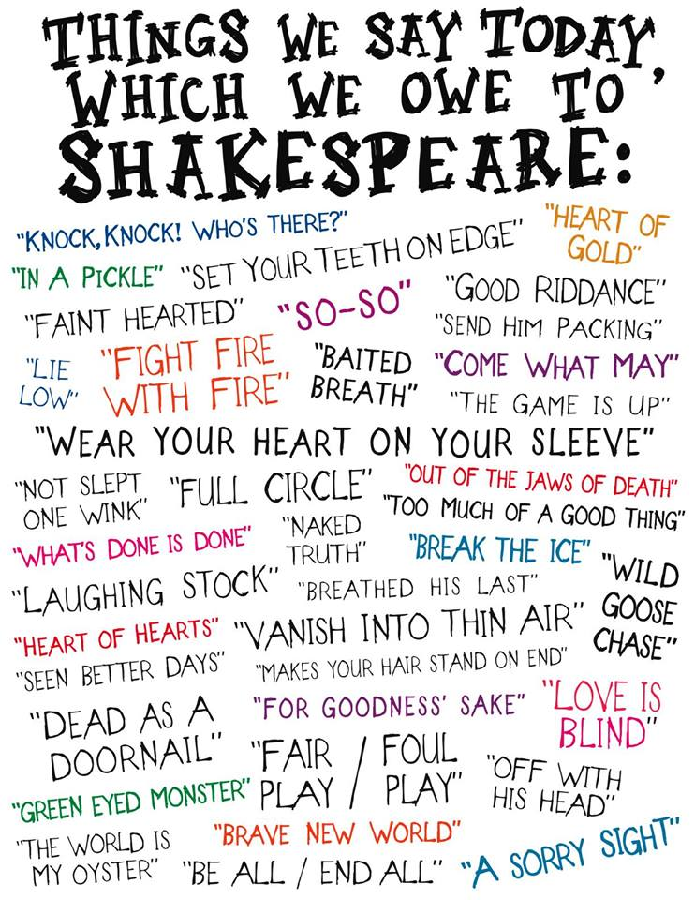
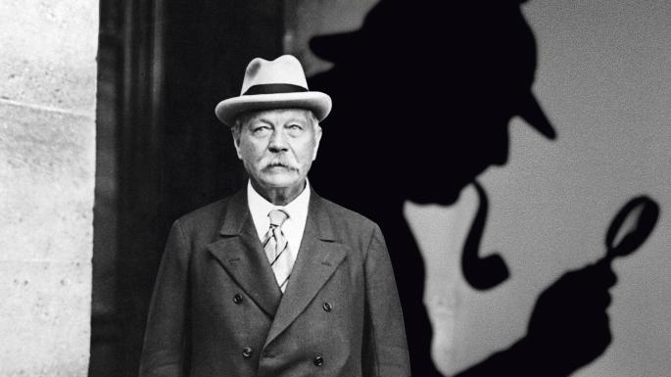
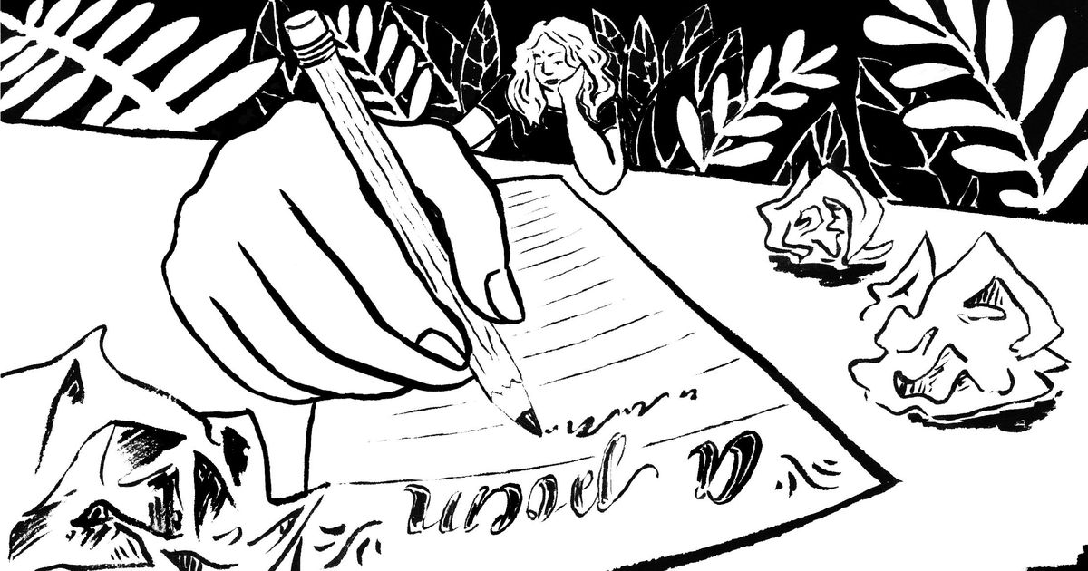
HOW to Prepare for literature:
Re-read the text and make additional annotations – students should always be actively reading. This means they should be annotating for key plot developments, highlighting key quotations, exploring the effect of language and structure and making connections across the whole text.
Use the Cottesloe School Literature revision websites and complete key tasks.

Slide 48
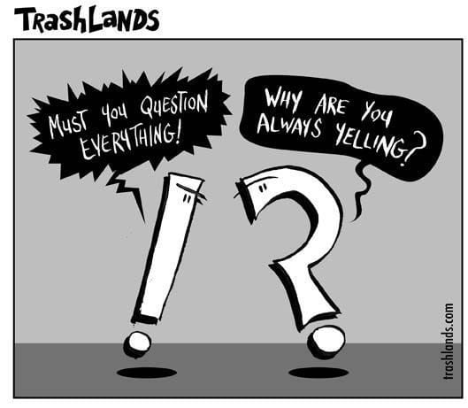
SPaG – eh?
Remember, there are an additional 4 marks on each of these papers allocated to spelling, punctuation and grammar. Students should ensure they always proofread their essay responses to earn those marks!

Slide 49
Context
Every student at the Cottesloe School will learn about the contextual factors surrounding the texts they are studying.
These texts are integral to British heritage and there are plenty of ways to brush up on your contextual knowledge!
One way students can do this is by listening to podcasts, for example the ‘GCSE English Revision Pod’ on Spotify.

Slide 50
What Students Can Do to succeed this year.
Understand what is expected for both examination papers in terms of: Timings / Each Question / Assessment Objectives / Mark Schemes/Examiners’ Reports
Practice Makes Perfect: complete as many past papers as possible.
Resilience is key: don’t give up! Ensure you fix every response to the best of your ability!
Accept all Offers of Help: come to revision sessions, form time / after school interventions.
Be Revision Smart: use the revision websites the English department at the Cottesloe School have created! Each website – one for Literature and one Language – is packed with useful revision tasks, links to YouTube revision videos, practice papers and more!

Slide 51
Key Examination Dates: English Literature
Assessments:
Students will complete exam-style literature assessments - in class - throughout the year.
Public Examinations:
Paper 1: 13th May, 2020
Paper 2: 21st May, 2020

Slide 52
Prepare Aspire succeed

Slide 53
MATHS

Slide 54
Assessment Structure
Mock Examinations:
Year 10 – June 2019
Year 11 – November 2019 and March 2020
Final Examinations
June 2020

Slide 55
How to improve your raw score:
Have a plan
Focus on Exam technique and preparation, little and often. Focus on the 4 steps:
Acquisition of knowledge
The application of knowledge
Question interpretation and problem solving skills
Exam practice

Slide 56
Tips for students:
Build the individual characteristics of Attitude, Confidence, Determination , Drive and Discipline.
Be effective and efficient.
Focus on organisation and fit your revision around your other subjects
Use the resources you have: Workbooks, Mymaths, and Exam papers.

